Slide 1
Ron Bonjean, Partner, ROKK Solutions Rich thau, President of Engagious Jon Last, President of Sports & Leisure Research Group Gina Derickson, Research director of Engagious
I’m getting by, but everything’s a mess
Public opinion insights from the June 17, 2020 “Back-to-Normal Barometer”

Slide 2
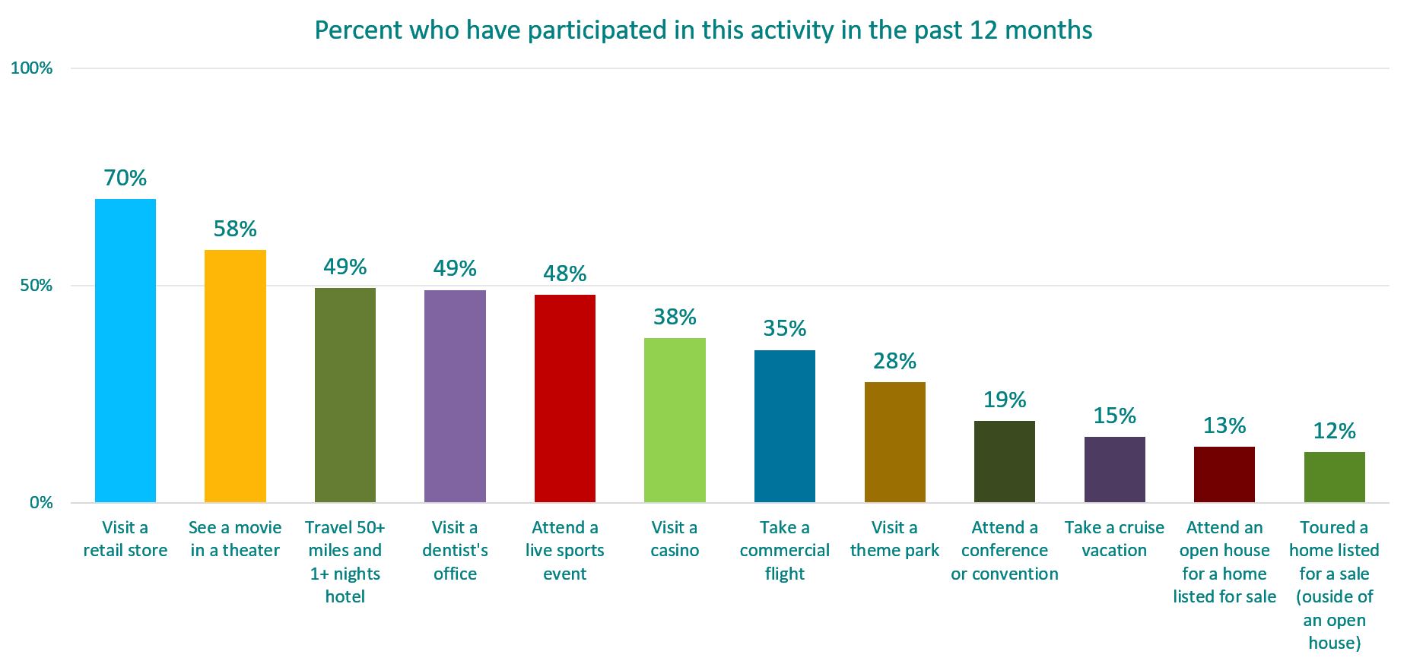
CONTEXT: respondents actively engage
n=565, Back to Normal Barometer, June 17, 2020

Slide 3
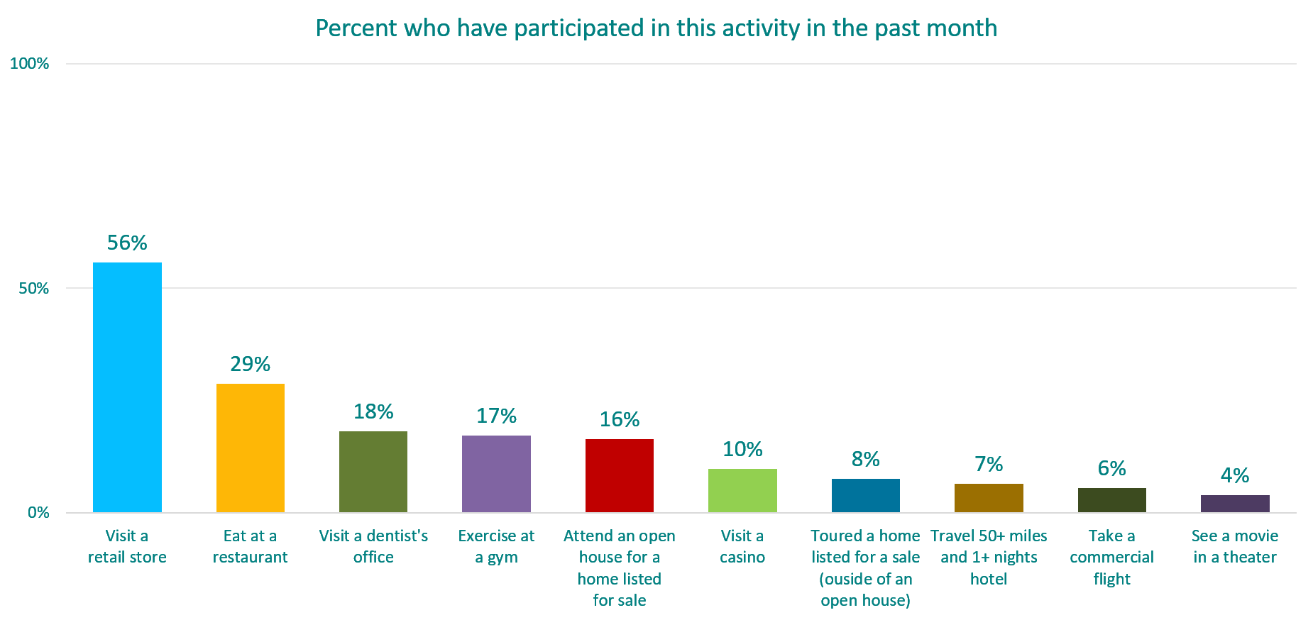
CONTEXT: some have started to venture out
n=565, Back to Normal Barometer, June 17, 2020

Slide 4
What are consumers most concerned about?
MEDICAL
$$$
UNREST
Potential to contract COVID-19
Impact on leisure activities
Personal Finances
-10
-10
-10
PERSONAL
38%
37%
37%
The overall public health crisis
Impact on
American society
The U.S. Economy
-5
-6
-9
SOCIETAL
53%
55%
48%
*Percentage who said they are extremely concerned
Wave 6: n=565 Back to Normal Barometer – June 17, 2020
Wave 5: n=613 Back to Normal Barometer – June 3, 2020

Slide 5
But…

Slide 6
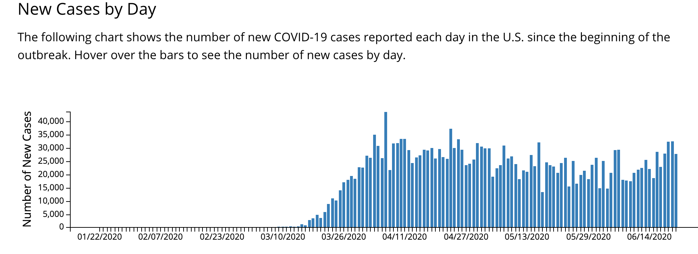
With cases rising…

Slide 7
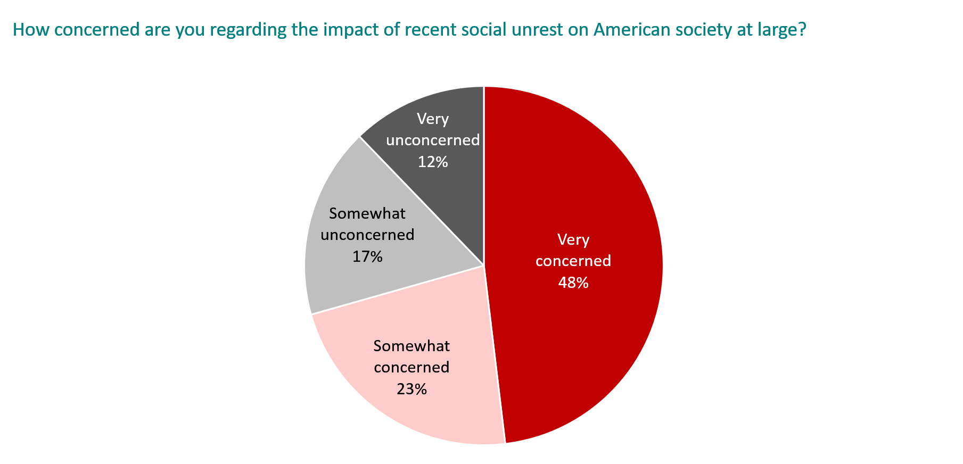
CONCERNS ABOUT SOCIAL UNREST PERSISTing…
n=565, Back to Normal Barometer, June 17, 2020

Slide 8
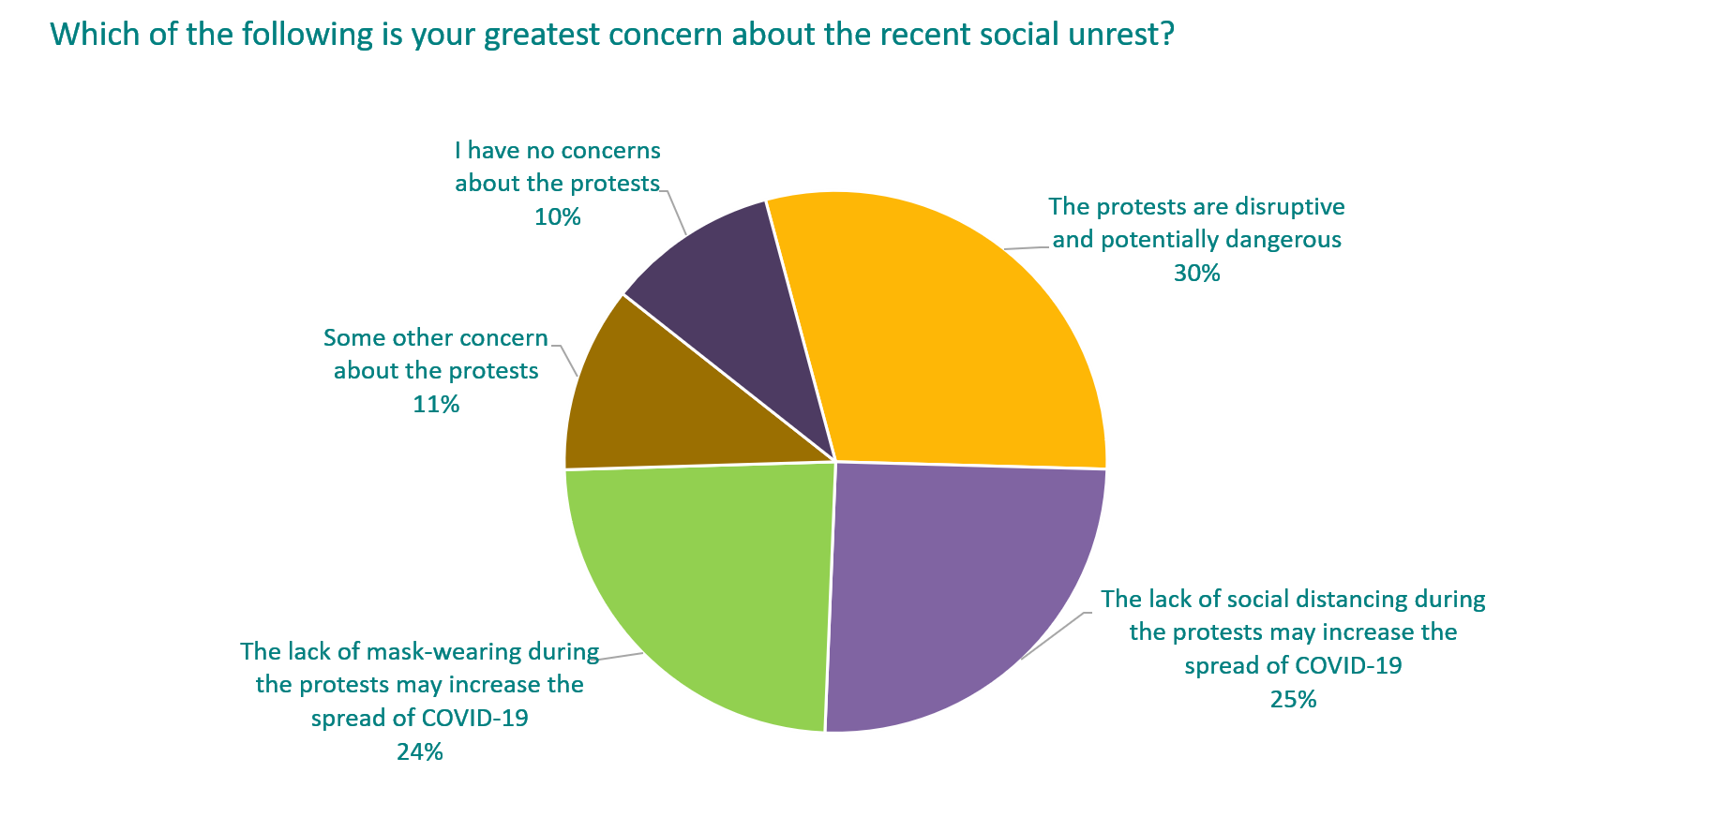
Social unrest exacerbating health fears…
n=314, Back to Normal Barometer, June 17, 2020

Slide 9
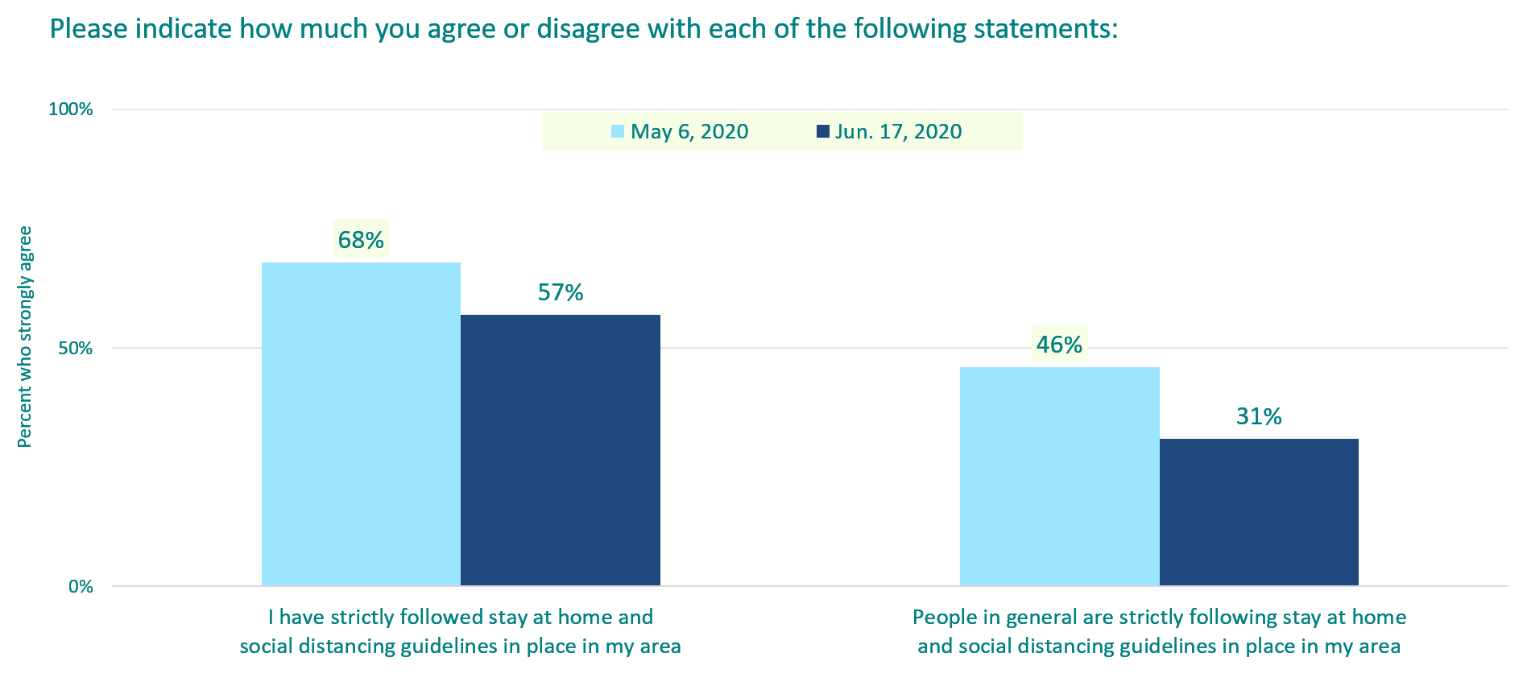
And others not following the rules…
n=565, Back to Normal Barometer, June 17, 2020

Slide 10
Confidence barometer: Back to where we began
Current Conditions
Confidence Barometer
-1
24%
-5
27%
Future Expectations
-9
31%
n=565, Back to Normal Barometer, June 17, 2020

Slide 11
Societal Future expectations hit new low
n=565, Back to Normal Barometer, June 17, 2020

Slide 12
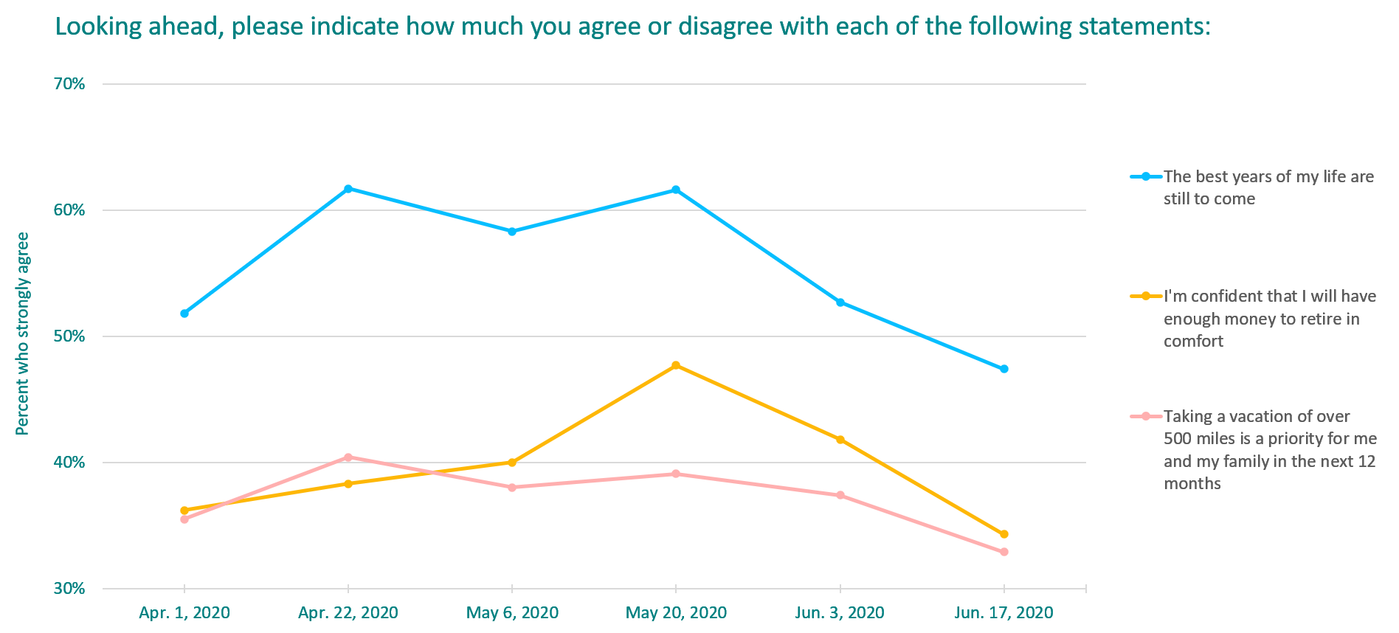
Personal Future expectations hit new low
n=565, Back to Normal Barometer, June 17, 2020

Slide 13
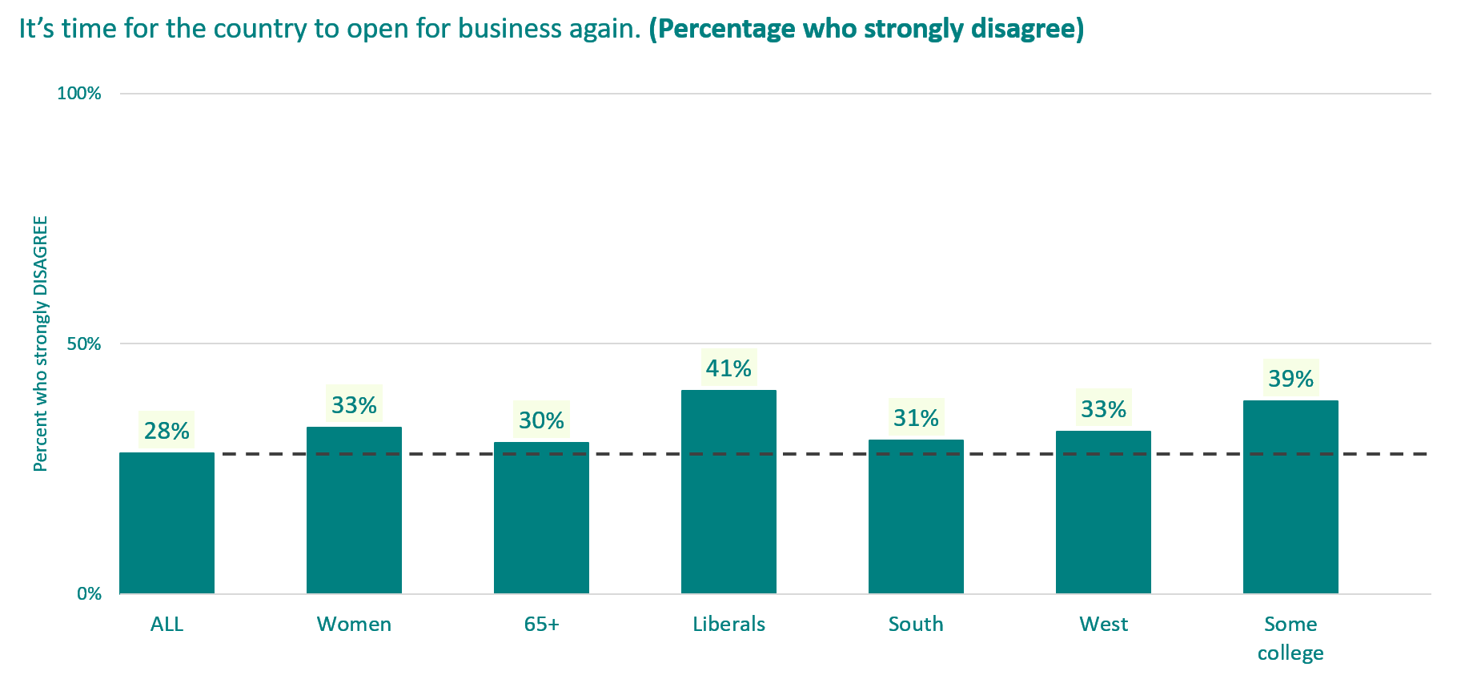
Sizable segments just not ready yet
n=708, Back to Normal Barometer, June 17, 2020

Slide 14
What it means for specific sectors

Slide 15
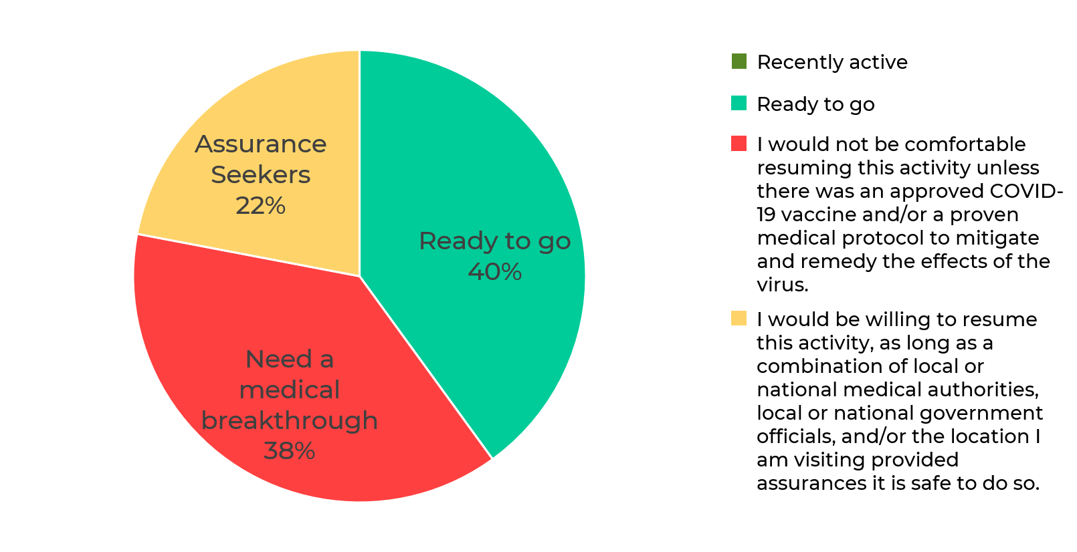
Engagement: Attend a conference or convention
Which of the following conditions is closest to your current point of view… Attend a conference
or convention
n=107, Back to Normal Barometer, June 17, 2020

Slide 16
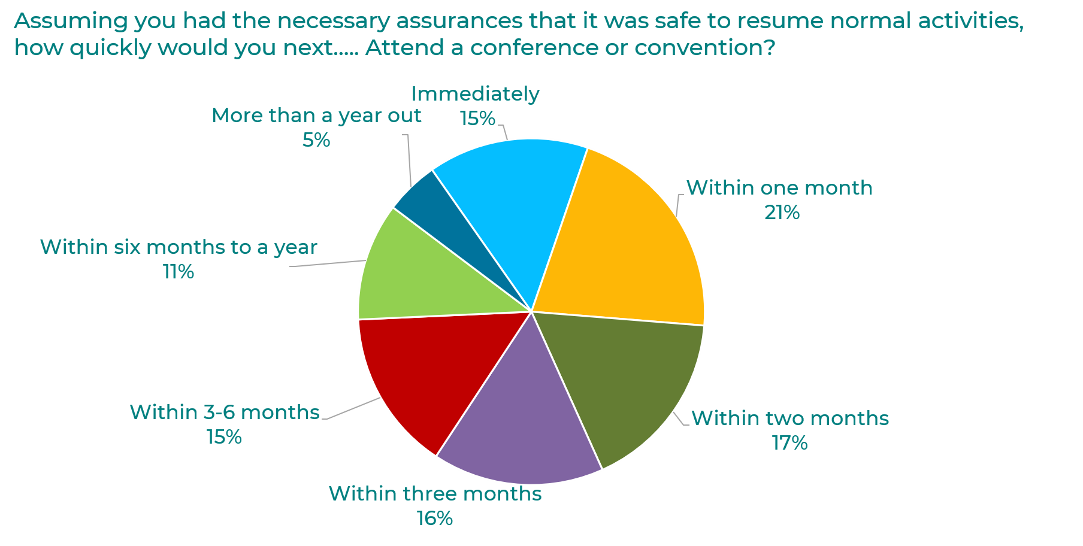
With assurances, 69% return in 3 months
n=107, Back to Normal Barometer, June 17, 2020

Slide 17
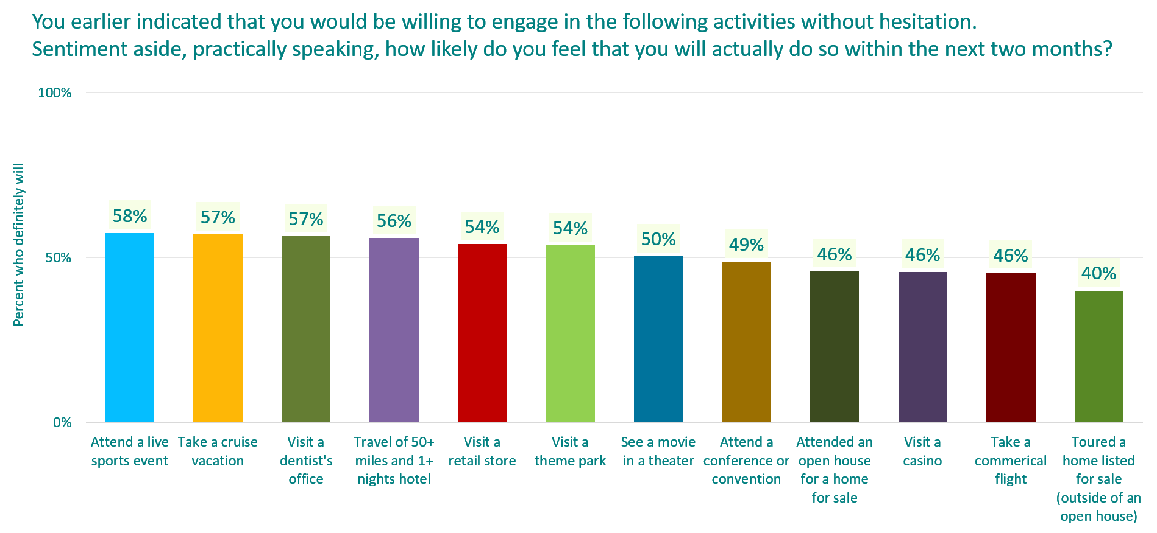
% “ready to go” who actually “will Go”
n=565, Back to Normal Barometer, June 17, 2020

Slide 18
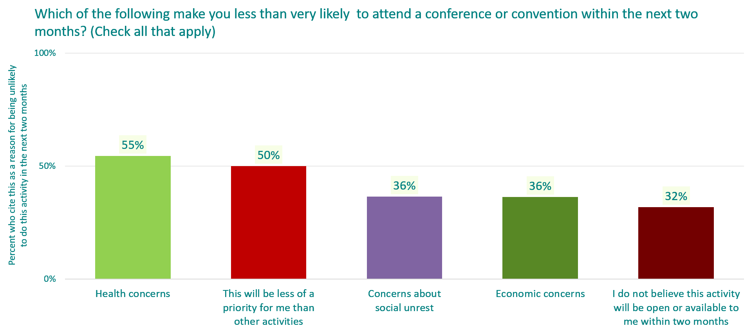
Ready to go, but won’t go soon—why NOT?
n=22, Back to Normal Barometer, June 17, 2020

Slide 19
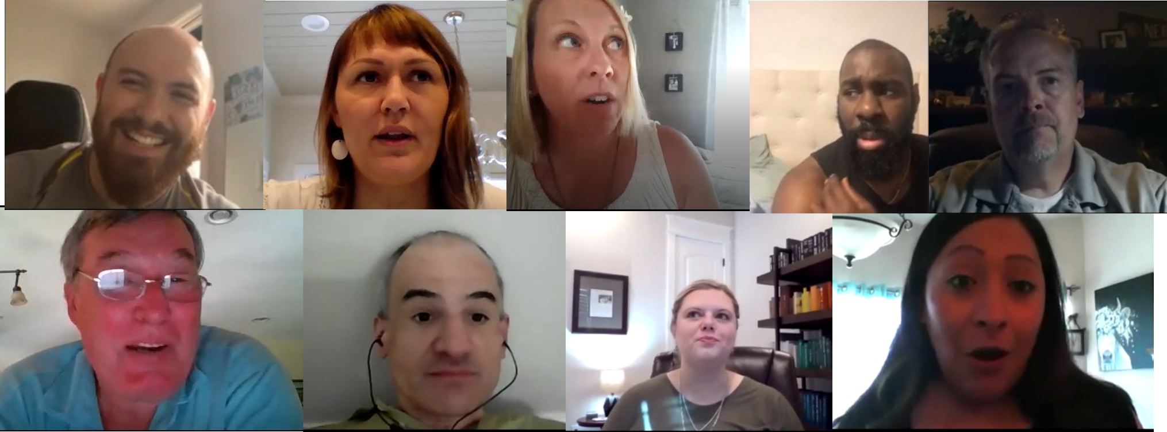
in-depth interviews
explain the hesitancy

Slide 20
No Clear directions = guess & Make your Own
Fears of a second wave of COVID-19
“Our neighboring states have an increase in numbers daily…so I try to ignore it as best as I can so that I don’t freak myself out.”
“[Opening the economy] is happening way too fast. I think we're going to regret a lot of these decisions in a couple of months.”
Even shopping requires thought
“There is a lot of general anxiety and tension… [Nobody] really fully knows what to do.”
“I tried on a few pairs of shoes, and just put the shoes back in the box again. I don't know if that was a right thing to do or not, but that's what I did.”
“I just had to assume when I walked in the carts by the entrance had been cleaned…but there was no sign.”
Unaware of the right boundaries, people create their own
Outdoor dining, local places to “escape” to, mask-wearing as door-opener

Slide 21
Testing – the key to returning?
More testing is good, but continued concerns about reliability and questionable benefits
Who should have a test? When?
Can you catch COVID-19 again?
“Given the newness of everything, it probably provides a false sense of security sometimes when somebody either tests negative or tests positive for the antibodies…like a ‘get out of jail free’ card.”
Necessary for vaccine development, but not sure how

Slide 22
Propensity to litigate against vendors

Slide 23
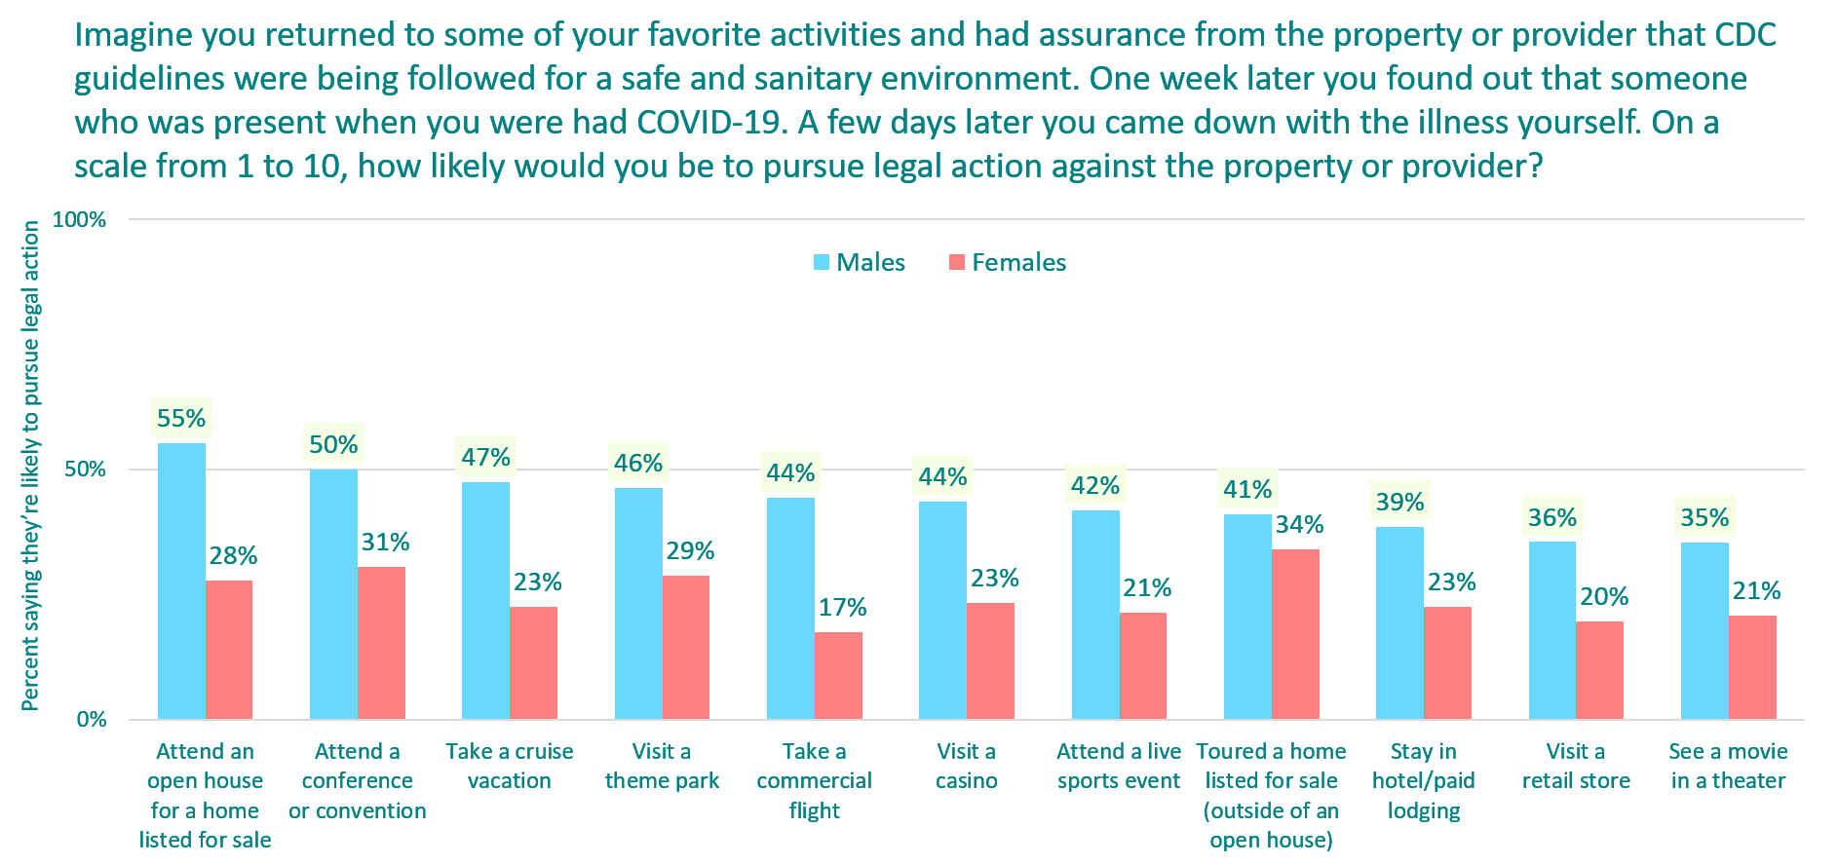
Every sector vulnerable to lawsuits
n=613, Back to Normal Barometer, June 3, 2020

Slide 24
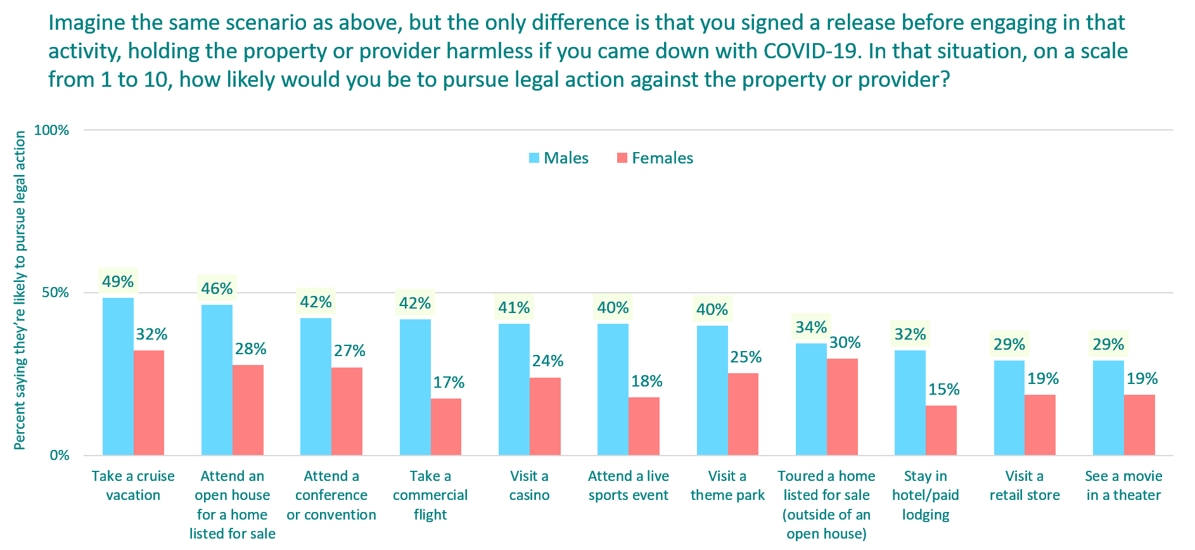
…even after customers sign a release
n=613, Back to Normal Barometer, June 3, 2020

Slide 25
Back to the workplace: Know what employees want…and expect

Slide 26
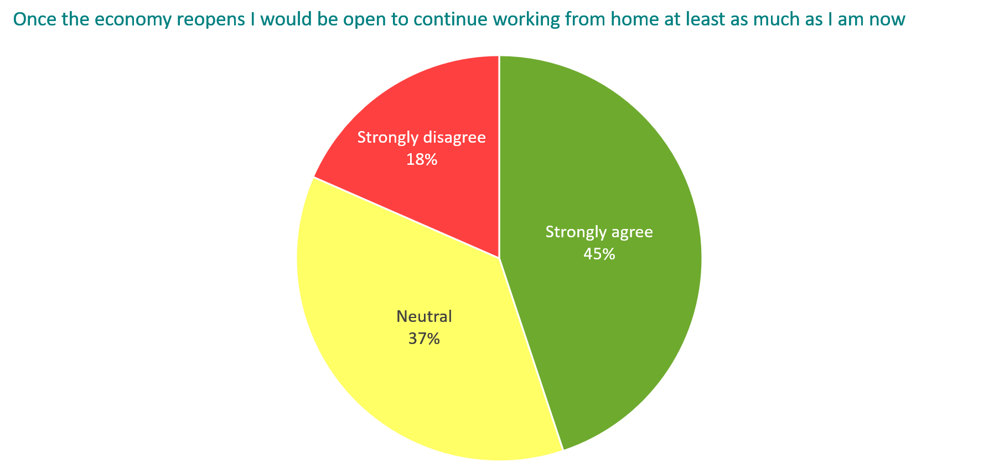
Many employees will still want to WFH
n=593, Back to Normal Barometer, May 20, 2020

Slide 27
…And will be sensitive to being back
“If my employer makes us use web-based video conferencing while at the office, I will question why we are working from the office in the first place.”
44% strongly agree
“If people can remove a mask in their personal offices, and people in common areas cannot, that is a form of discrimination.”
32% strongly agree

Slide 28
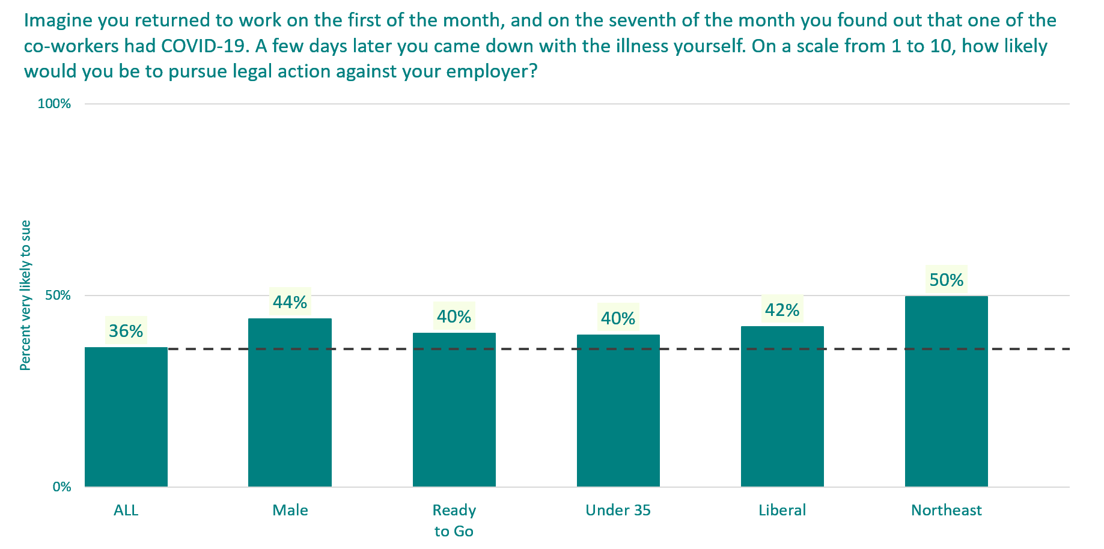
employees willing to sue their employerS
n=504, Back to Normal Barometer, May 20, 2020

Slide 29
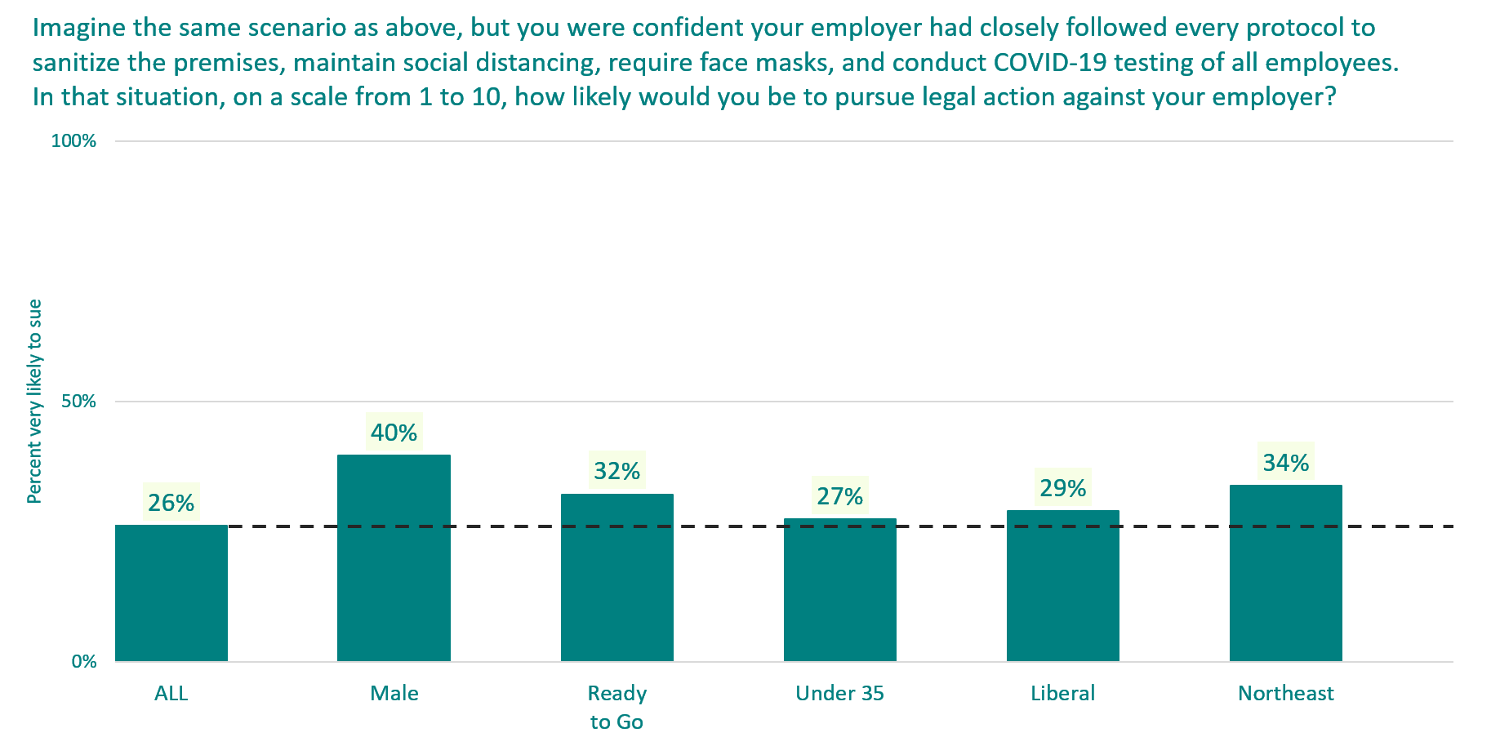
employees willing to sue their employerS
n=202, Back to Normal Barometer, May 20, 2020

Slide 30
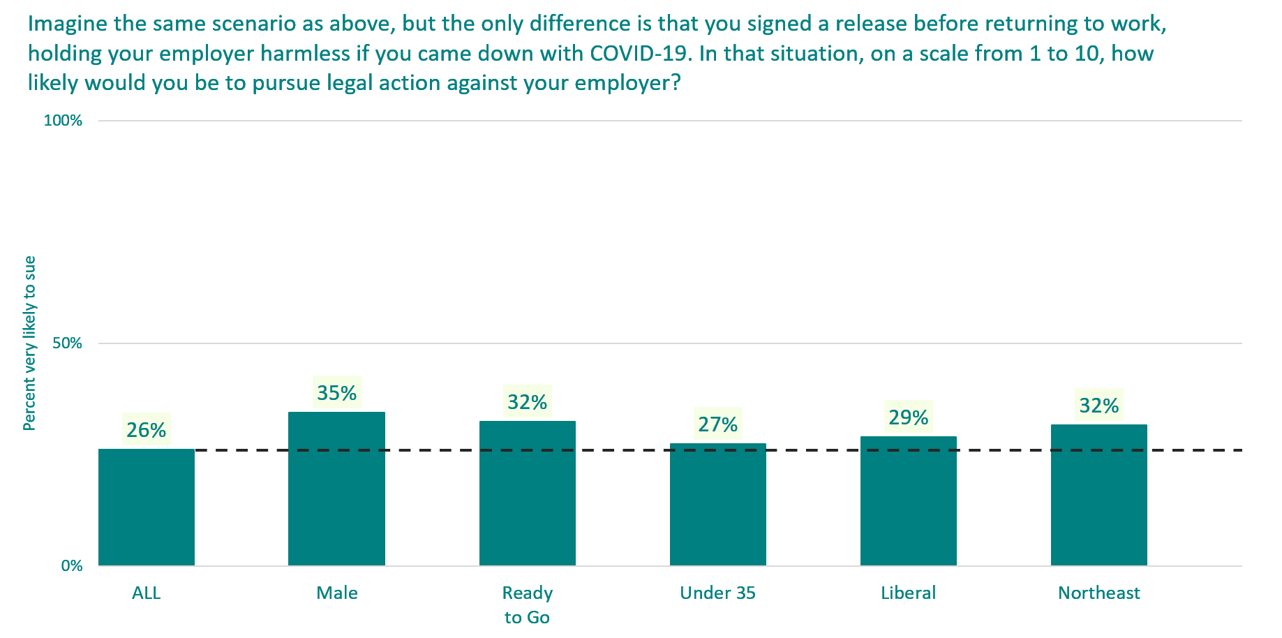
Release-signing employees willing to sue employer
n=221, Back to Normal Barometer, May 20, 2020

Slide 31
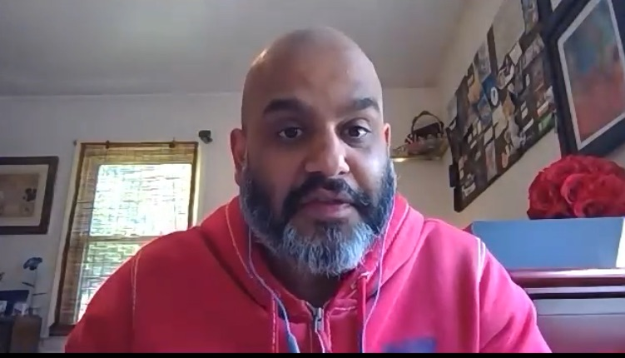
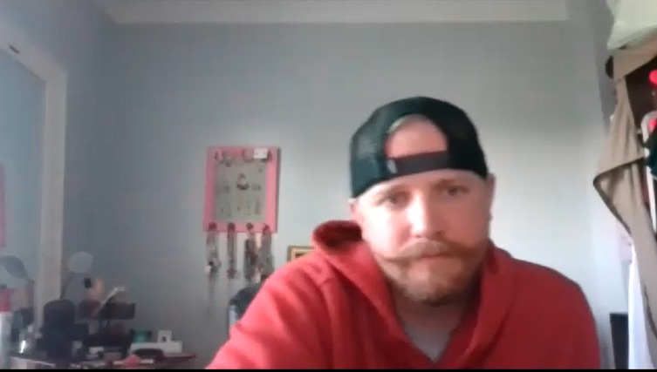
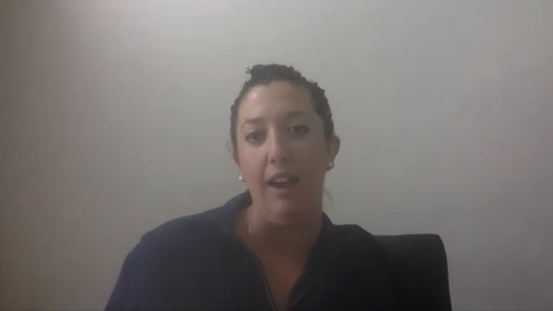
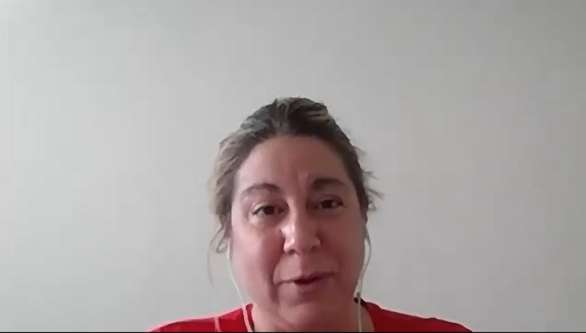
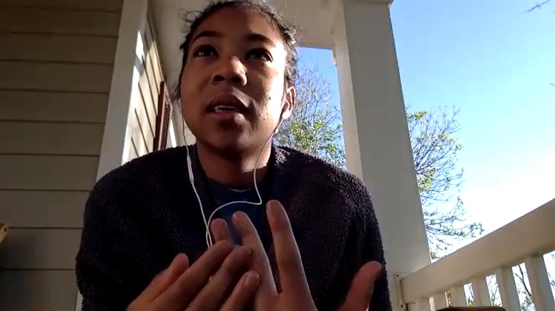
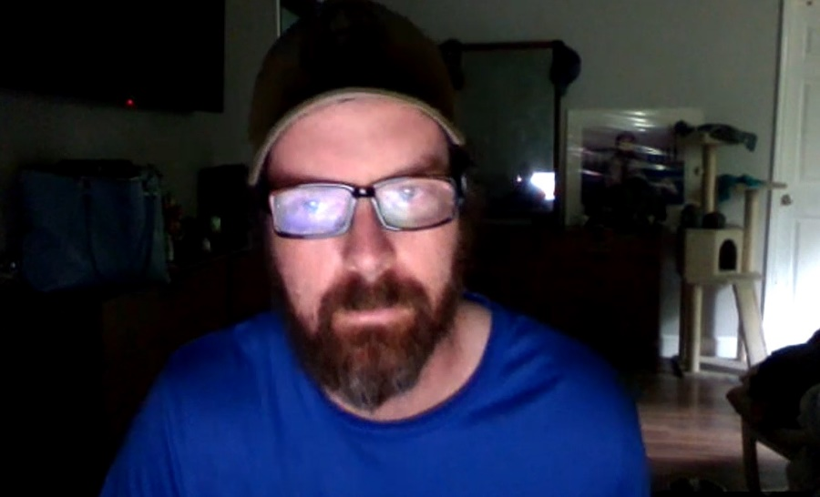
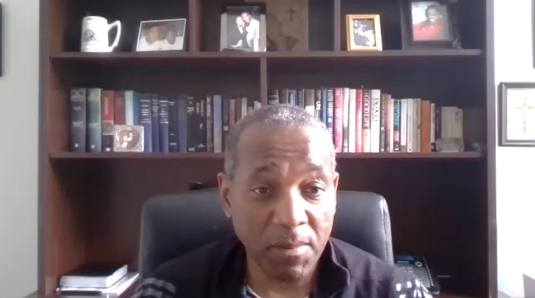
Take a deep breath; most won’t sue

Slide 32
Take a deep breath; most won’t sue
They are realistic about the situation
Hesitant to sue employer unless they are lackadaisical
Employees must assume a level of risk returning to work
Difficult to trace illness with a specific exposure
What should companies do to avoid legal conflicts?
State the “rules” for returning; follow and enforce them consistently
Take care of people who become sick with COVID-19
Hold a re-orientation for employees to review policy changes
Sign an agreement that employees will follow rules and company isn’t liable

Slide 33
Online dial test: A boss anticipates her staff’s return

Slide 34
Getting Moment-to-moment feedback
36 working-from-home Americans watched a two-minute video embedded in an online survey
They were told: “You are going to see a video that could be from the president of any small or midsize business in America that operates out of an office, but where the employees currently are working from home. I’d like you to imagine, for the sake of this exercise, the person in the video is your boss, and has made this video to send to all employees.”

Slide 37
Why did people 55-64 push back?
“ [It was the] company’s expectations [for] everyone to return to the workspace regardless of how people felt. There was no choices. There was no options to work from home if the people can be productive. There was no special cases for people who have health issues.”
—Female, 55-64
“THE COMPANY DOESN'T SEEM TO REALLY CARE ABOUT EMPLOYEES AND IS JUST COVERING THEIR ASSES.”
—Male, 55-64

Slide 38
Why did those under 35 embrace it?
“I think that the video is very encouraging by helping people…
be hopeful about the coronavirus.”—Female, 18-34
“They can allow people [to] work from home if they have symptoms.”
—Female, 18-34
“She wants to make sure everyone is safe, and understands what to do when going back to work.”—Male, 18-34

Slide 39
Questions?
What questions do you have about the findings?
What should we ask in wave 7?
What are the biggest open questions you’re facing now?

Slide 40
Ron Bonjean, ron@rokksolutions.com Rich Thau, rich@engagious.com Jon Last, jlast@sportsandleisureresearch.com Gina Derickson, gina.derickson@engagious.com

